Slide 1
ACTIVITY 1
Create a flowchart and pseudo code

Slide 2
PROBLEM 1
We want to create a flow char/pseudo code that prints out double the number of the inputted value.

Slide 3
PROBLEM 2
We want to create a flow char/pseudo code that convert the length in feet to centimeter.

Slide 4
PROBLEM 3
We want to create a flow char/pseudo code that reads in a number, and checks if it is odd or even.

Slide 5
PROBLEM 4
We want to create a flow char/pseudo code that prints out the biggest of three inputted numbers

Slide 6
PROBLEM 5
We want to create a flow char/pseudo code that prints out the word “Honour” if the number input is 70, if the number is less than 40 print out the word “Fail”, otherwise print out the word “Pass”.

Slide 7
PROBLEM 6
We want to create a flow char/pseudo code that prints out the average value of five numbers input in

Slide 8
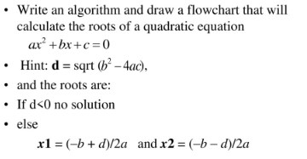
PROBLEM 7

Slide 9
PROBLEM 8
Write an algorithm that reads two values determines the largest value and prints the largest value with an identifying message

Slide 10
PROBLEM 9
Write a algorithm
Read an employee name(NAME). Overtime hours worked (OVERTIME), hours absent(ABSENT) and
Determine the bonus payment (PAYMENT)

Slide 11
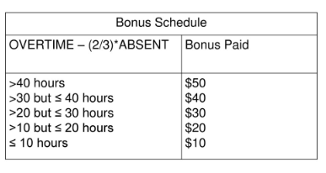
PROBLEM 9

Slide 12
PROBLEM 10
Express an algorithm to get two numbers from the user (dividend and divisor), testing to make sure that the divisor number is not zero, and displaying their quotient using a flowchart

